Slide 1
Embedded Hardware: Hardware Building Blocks Board I/O

Slide 2
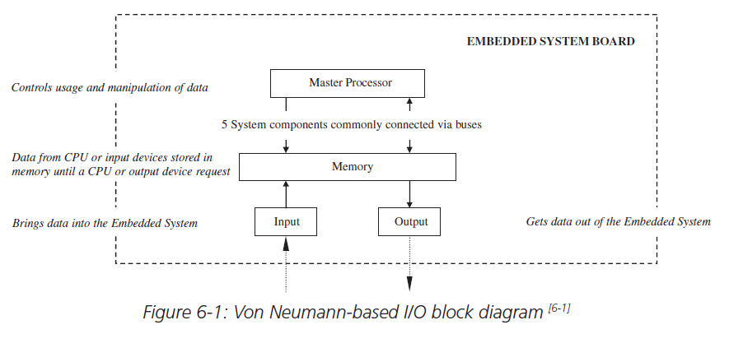
Introducing board I/O
Responsible for moving information into and out of the board to I/O devices connected to an embedded system
Input components: bring information from an input device to the master processor
Output components: take information out of the master processor to an output device

Slide 3
I/O devices types
Networking and communications I/O (the physical layer of the OSI model)
Input (keyboard, mouse, remote control, vocal, etc.)
Graphics and output I/O (touch screen, CRT, printers, LEDs, etc.)
Storage I/O (optical disk controllers, magnetic disk controllers, magnetic tape controllers, etc.)
Debugging I/O (BDM, JTAG, serial port, parallel port, etc.)
Real time and miscellaneous I/O (timers/counters, analog-to-digital converters and digital-to-analog converters, key switches, and so on)

Slide 4
I/O hardware-six main logical units
Transmission medium- a wireless or wired medium connecting the I/O device to the embedded board
Use: data communication and exchanges
Communication port: transmission medium connects to on the board
A communication interface: manages data communication between master CPU and I/O controller
Use: responsible for encoding and decoding
An I/O controller: a slave processor that manages the I/O device
I/O buses: connection between the board I/O and master processor
The master processor integrated I/O

Slide 5
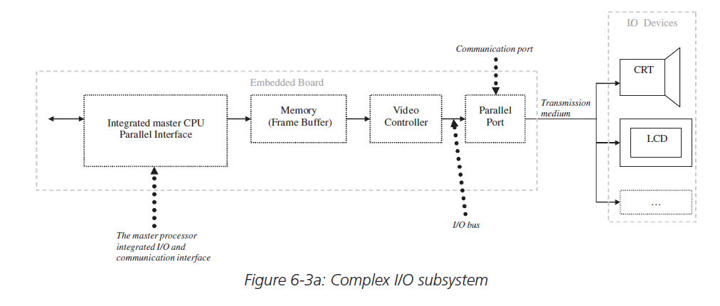
Cont’d

Slide 6
Serial I/O
Serial interfaces handles the serial data transmission and reception between the master CPU and I/O controller
Data can be transmitted between two devices three different ways:
In a one-way direction
In both directions but at separate times because they share the same transmission line
In both directions simultaneously

Slide 7
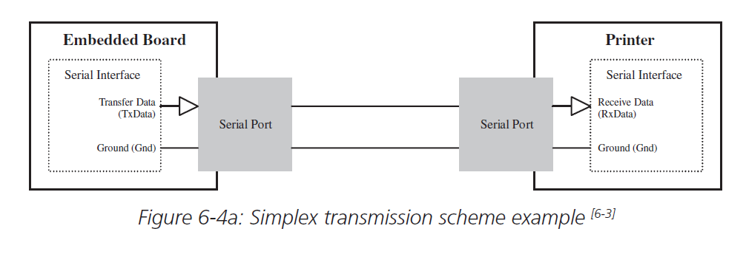
Simplex scheme
Simplex scheme is one in which a data stream can only be transmitted and received in the one direction
Example: Recorded lectures

Slide 8
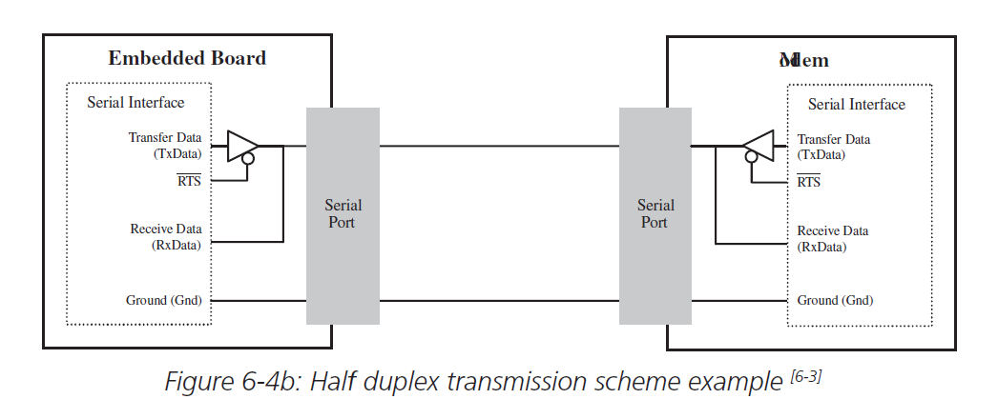
Half-Duplex Scheme
A half duplex scheme is one in which a data stream can be transmitted and received in either direction, but in only one direction at any one time
Example: walkie-talkie

Slide 9
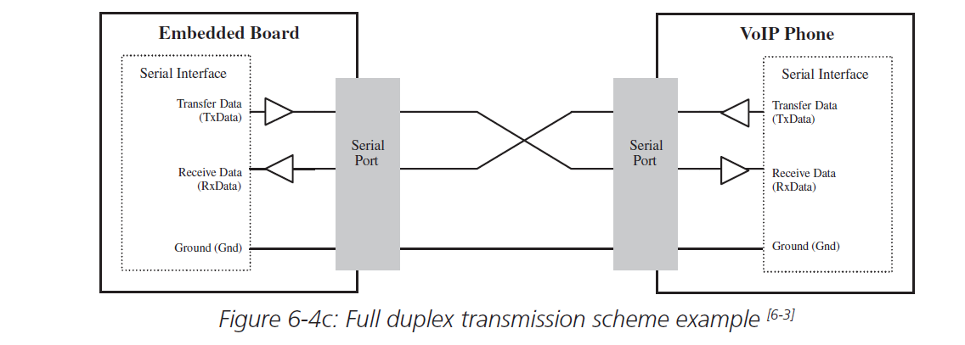
Full duplex Scheme
A full duplex scheme is one in which a data stream can be transmitted and received in either direction simultaneously
Example: All smart phone calls

Slide 10
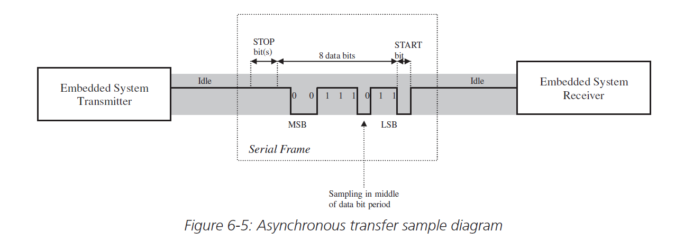
Synchronous vs asynchronous transfer
Serial I/O transfers can occur either as
Synchronous transfer: Steady stream at regular intervals regulated by the CPU’s clock
Asynchronous transfer: Intermittently at irregular (random) intervals

Slide 11
Asynchronous transfer
In an asynchronous transfer, the data being transmitted is typically stored and modified within a serial interface’s transmission buffer
The serial interface at the transmitter divides the data stream into groups, called packets
Packets of size 4 to 8 bits per character/ 5 to 9 bits per character
Each of these packets is then encapsulated in frames to be transmitted separately
The frames are packets modified in order to include the “START” bit, “STOP” bit and a parity bit
START bit - The start of a frame
STOP bit - the end of a frame
Parity bit - basic error checking (Optional)

